Slide 1
CuKNN
BY : ANUSHKA SINGH
(19114011)

Slide 2
Introduction
K-Nearest Neighbor is one of the simplest Machine Learning algorithms based on Supervised Learning technique.
The KNN algorithm assumes that similar things exist in close proximity.
KNN algorithm at the training phase just stores the dataset and when it gets new data, then it classifies that data into a category that is much similar to the new data.
It is also called a lazy learner algorithm because it does not learn from the training set immediately instead it stores the dataset and at the time of classification, it performs an action on the dataset.

Slide 3
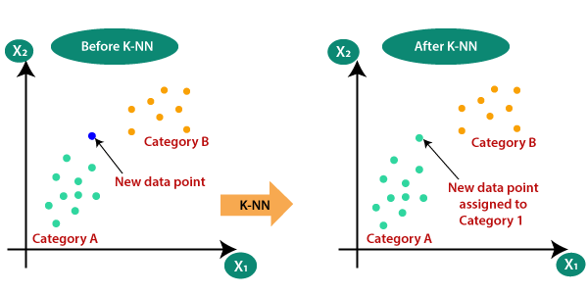

Slide 4
KNN Algorithm
Load the data
Initialize K to your chosen number of neighbors
For each example in the data
Calculate the distance between the query example and the current example from the data.
Add the distance and the index of the example to an ordered collection.
Sort the ordered collection of distances and indices from smallest to largest (in ascending order) by the distances.
Pick the first K entries from the sorted collection.
Get the labels of the selected K entries.

Slide 5
References
For CUDA Programming:
https://www.olcf.ornl.gov/wp-content/uploads/2013/02/Intro_to_CUDA_C-TS.pdf
For KNN :
https://en.wikipedia.org/wiki/K-nearest_neighbors_algorithm

